Slide 1
모듈 장착형 다용도 로봇 플랫폼
광역딜
2016741012 문석준
2017741021 김태겸
2017741025 장재우
2017741052 최석원

Slide 2
Index
1
Project Concept
2
Current Process
3
Issues
4
Schedule

Slide 3
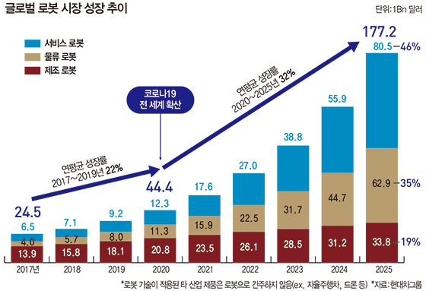
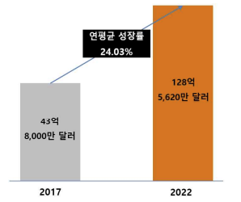
Project Concept
Ingrowing AMR & Service robot market
국제 AMR 시장 규모 및 전망(출처: 연구개발특구진흥재단)

Slide 4
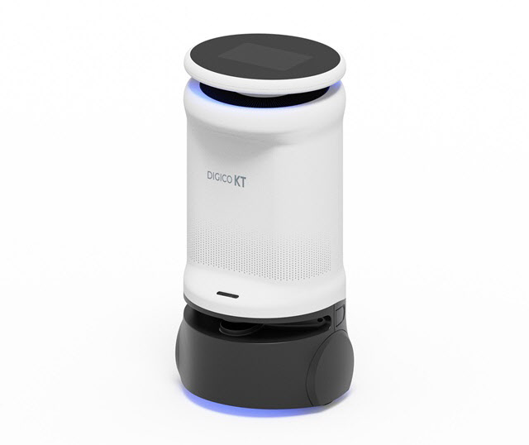
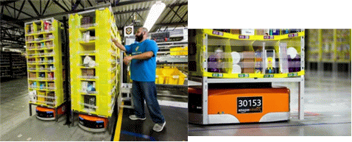
Project Concept
Problem about existing robots
Expensive price
KT 중소형 방역로봇
아마존(Amazon) Kiva
$20,000
$50,000

Slide 5
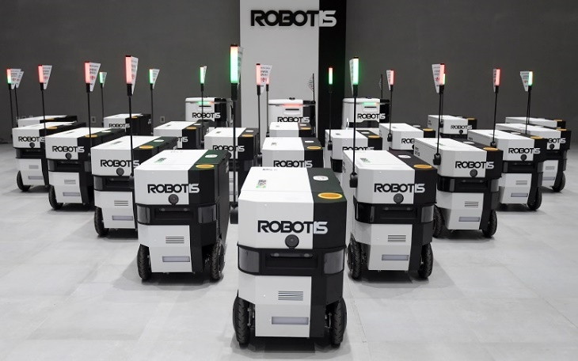
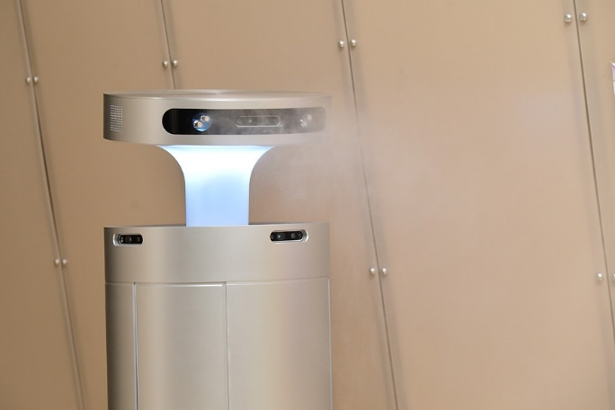
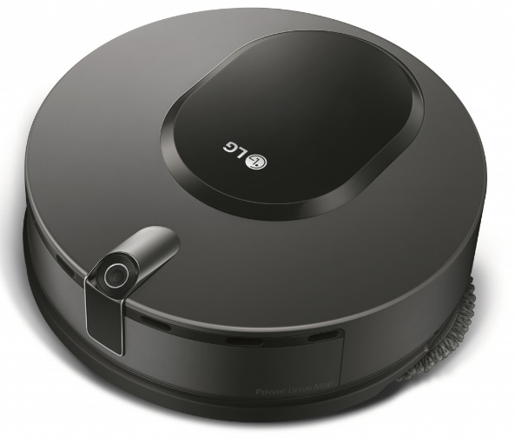
Project Concept
Problem about existing robots
One robot, one purpose
Fixed hardware, low adaptability

Slide 6
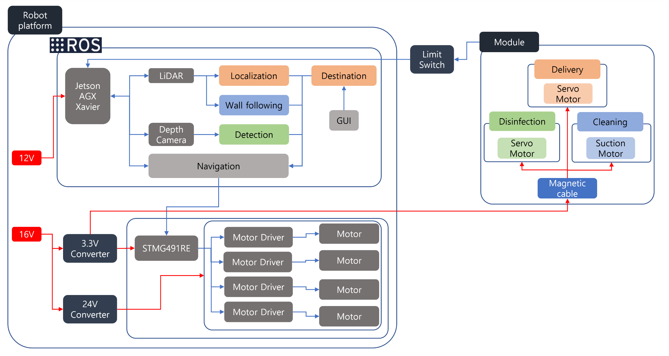
Project Concept

Slide 7


Project Concept
Delivery Module
Robot platform
User
Goal
password
Delivery
Node
Goal
Navigation
GUI
Goal
Current Pose
Feedback(Goal Reached,
Current State)
Localization
Linear Vel
Angular Vel
Goal Reached
Control
System
Control
System
Password
Sensors
Lidar
Camera

Slide 8


Project Concept
Disinfection Module
Robot platform
User
Button Click
Signal
Disinfection Node
Goal
Navigation
GUI
Feedback(Goal Reached,
Current State)
Current Pose
Disinfection Candidate Place Pose, Robot Pose
Localization
Information Manage Node
Linear Vel
Angular Vel
Goal Reached, Disinfection Signal
Control
System
Control
System
Sensors
Lidar
Camera

Slide 9


Project Concept
Cleaning Module
Robot platform
User
Button Click
Signal
Current Pose
Localization
GUI
Cleaning Node
Goal
Wall Following Algorithm
- Linear Vel
- Angular Vel
Cleaning Signal
Control
System
Control
System
Sensors
Lidar
Camera

Slide 10
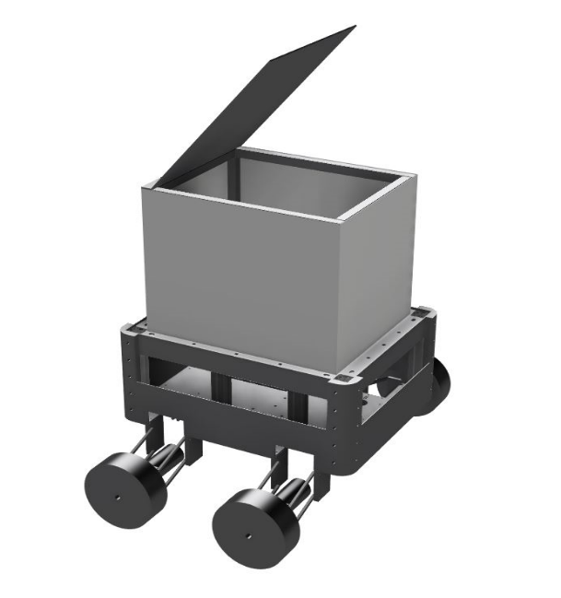
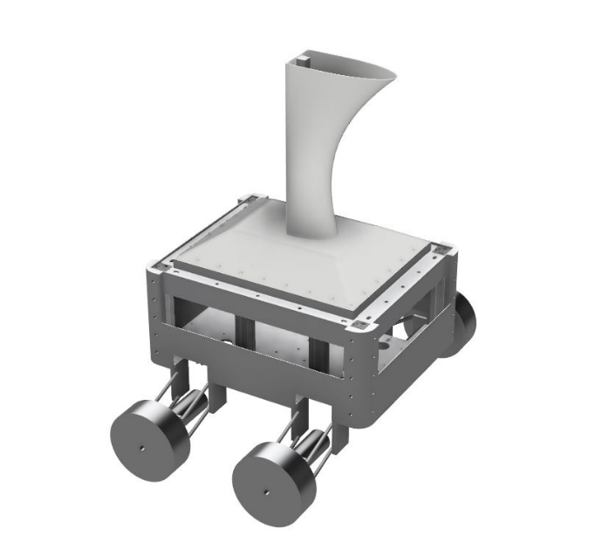
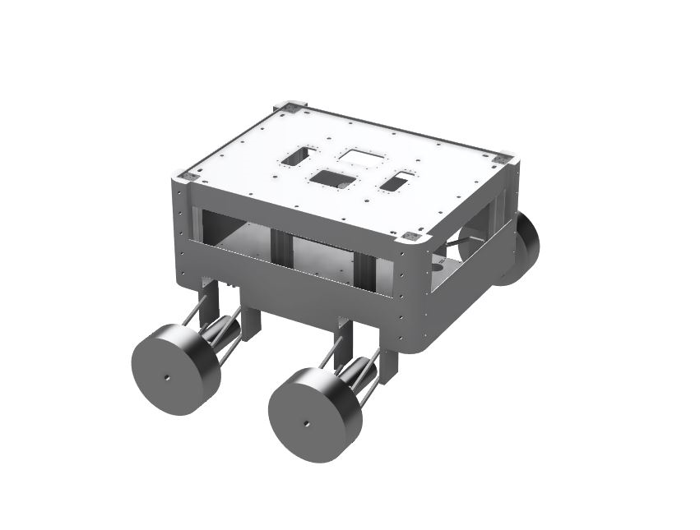
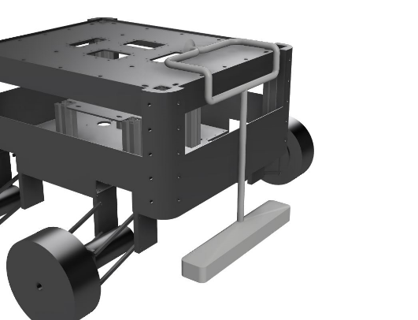
Project Concept
Proposal
One robot, many possibility
Changeable hardware, high adaptability
Robot platform + modules

Slide 11
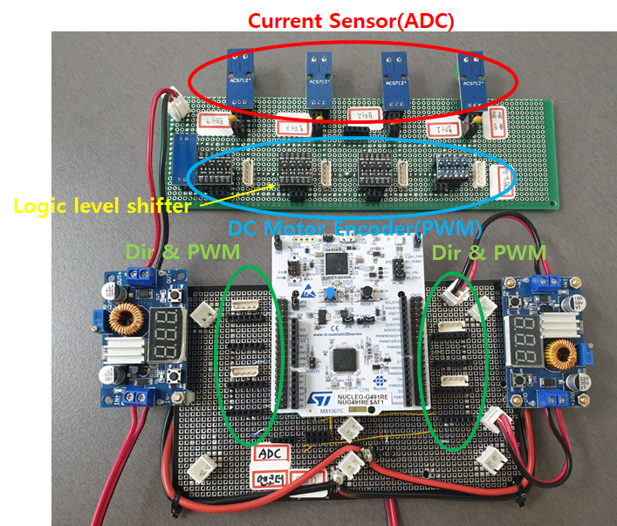
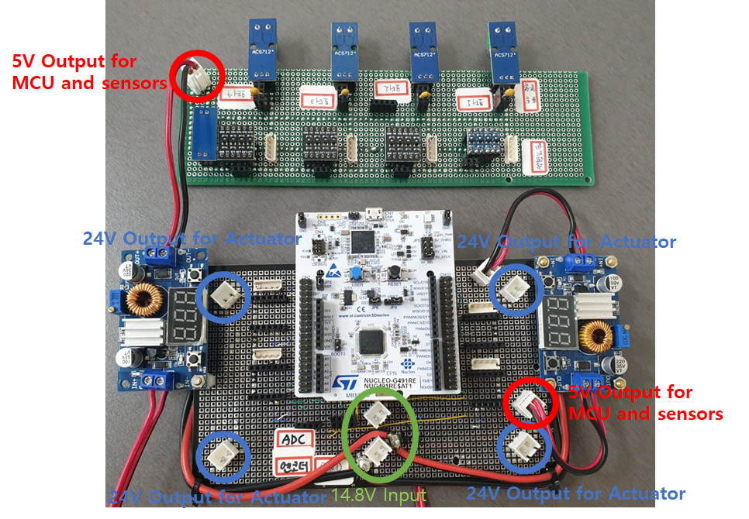
Current Process
Embedded system
Main voltage 16V
Motor 24V
MCU 3.3V (external 5V)

Slide 12
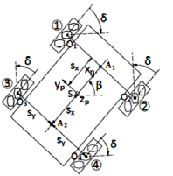
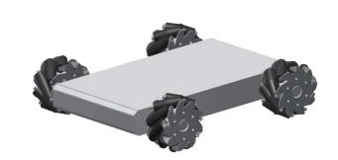
Current Process
Hardware base frame design

Slide 13
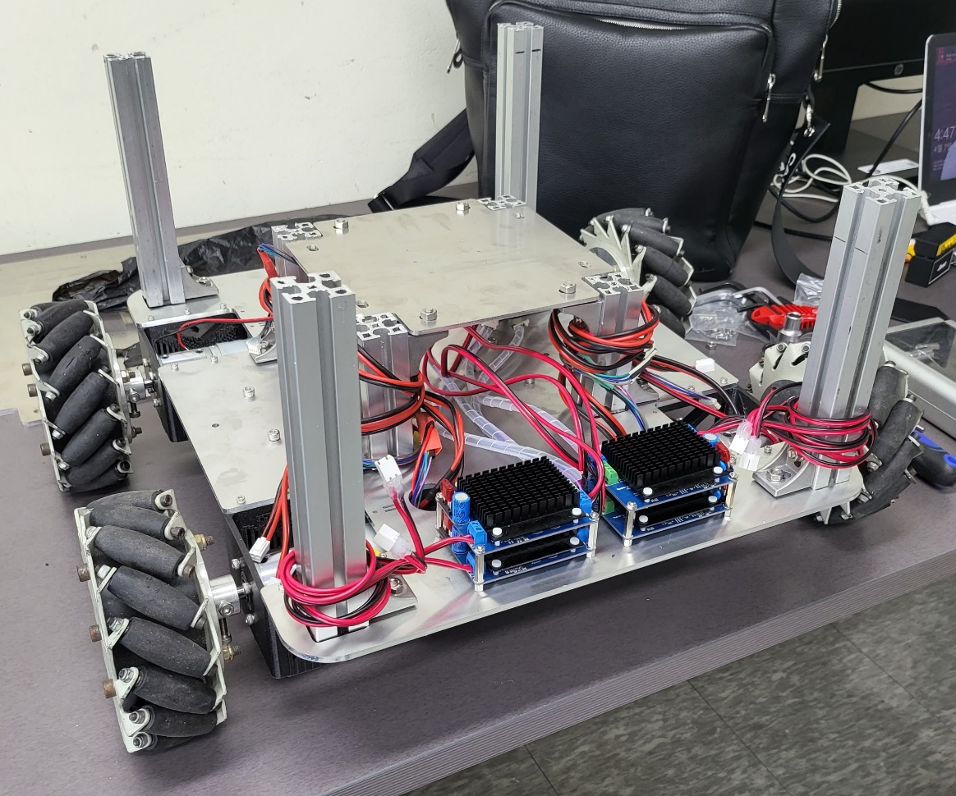
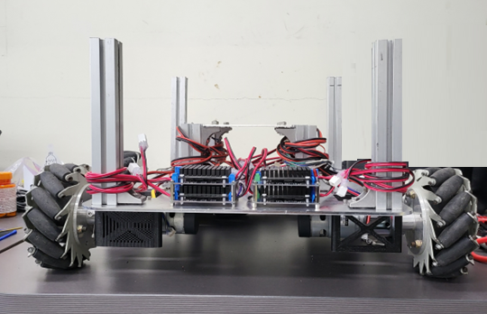
Current Process
Hardware assemble

Slide 14
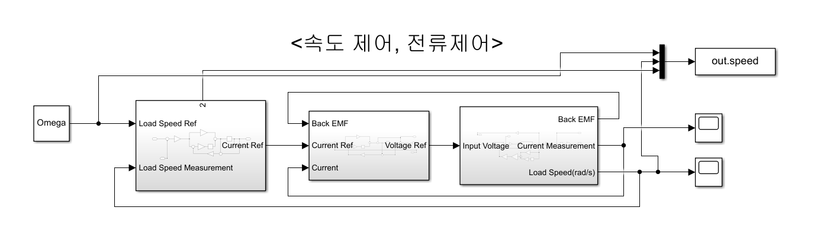
Current Process
Motor controller

Slide 15
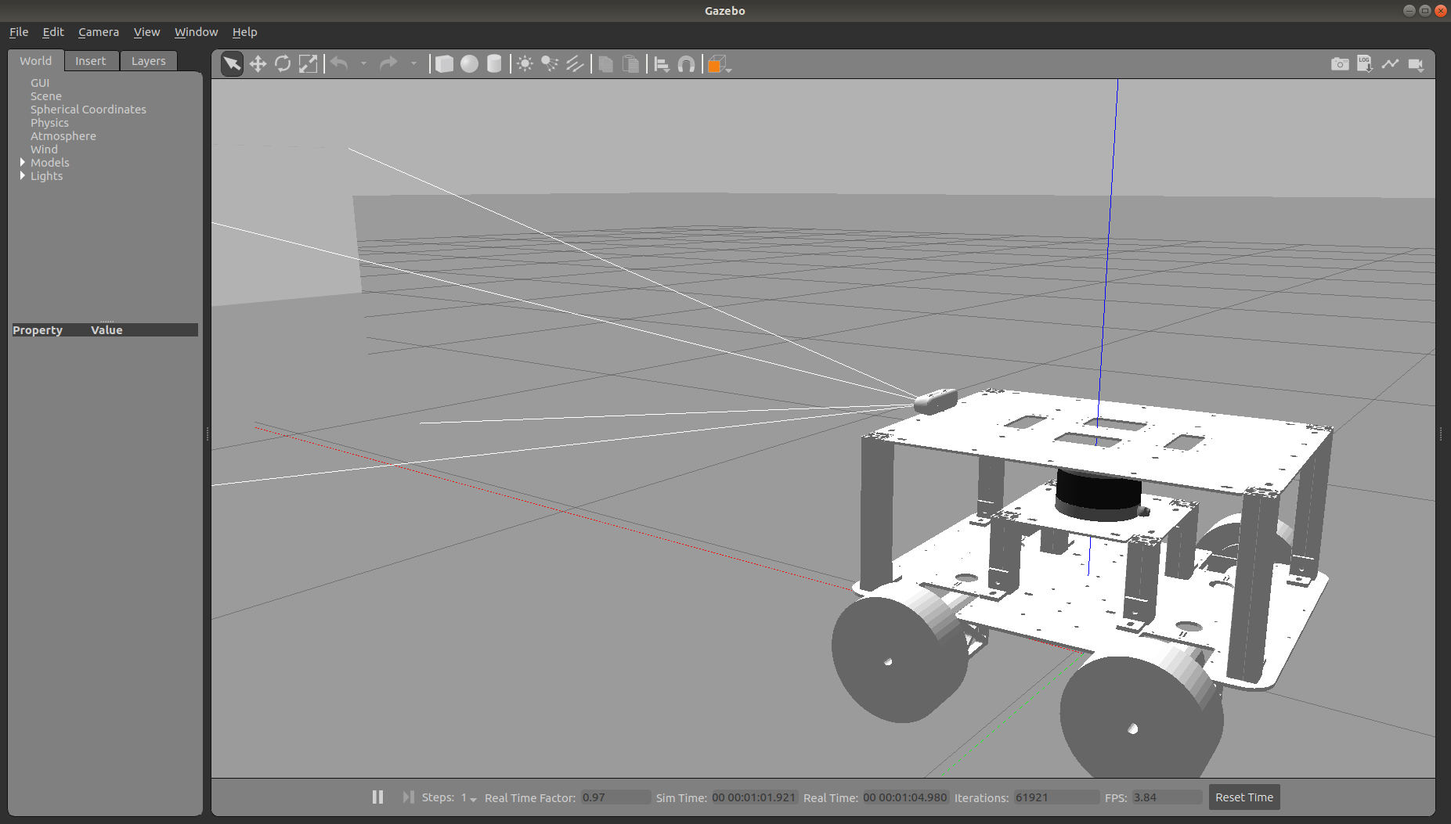
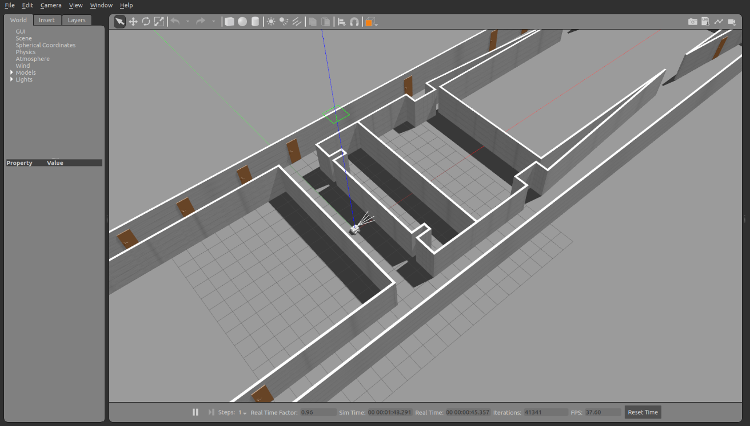
Current Process
Gazebo Simulation
Robot platform
Nuri 3rd world

Slide 16
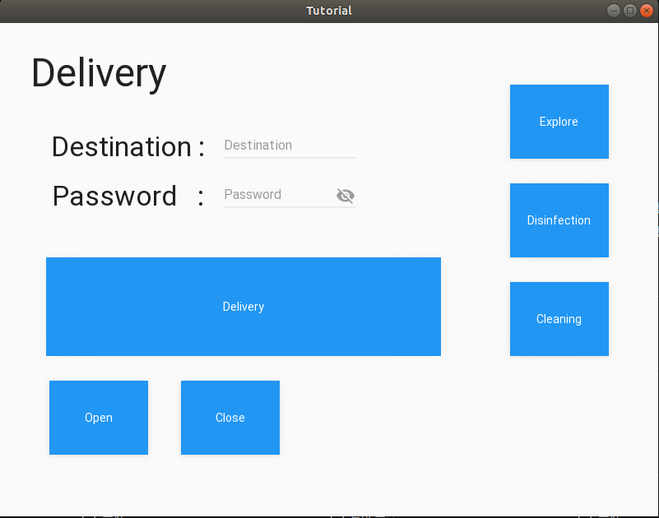
Current Process
Delivery
GUI

Slide 17
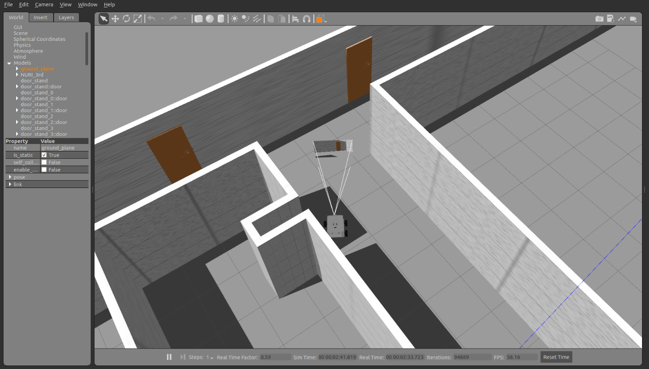
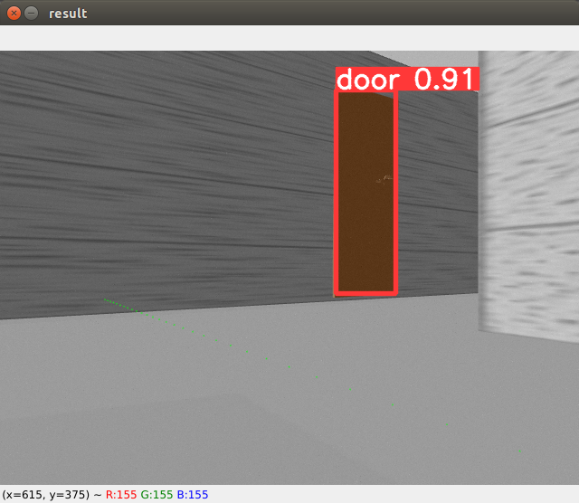
Current Process
Disinfection
YOLOv5 & TensorRT

Slide 18
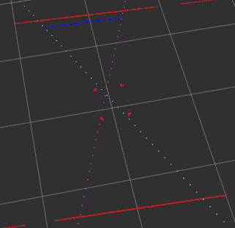
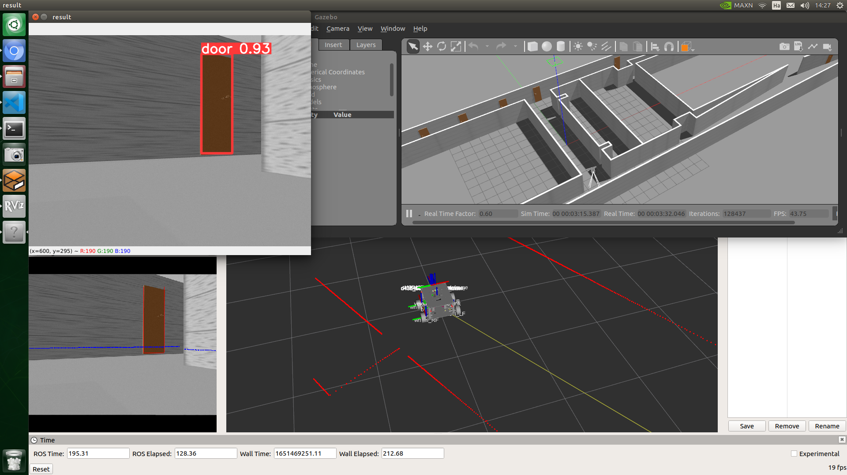
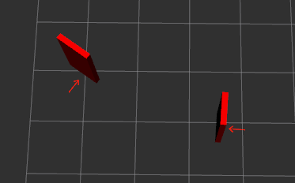
Current Process
Disinfection
Dore pose estimation with 2D LiDAR

Slide 19
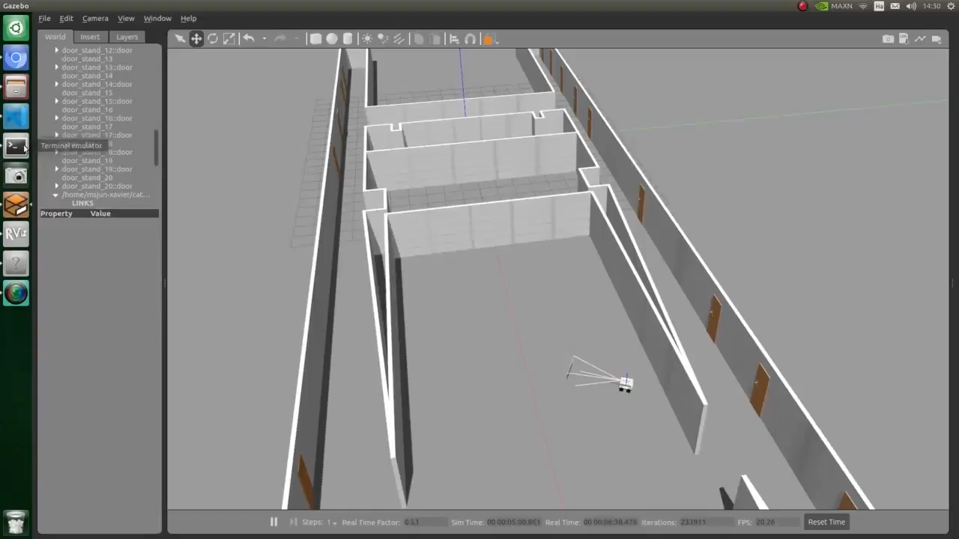
Current Process
Cleaning
Wall following

Slide 20
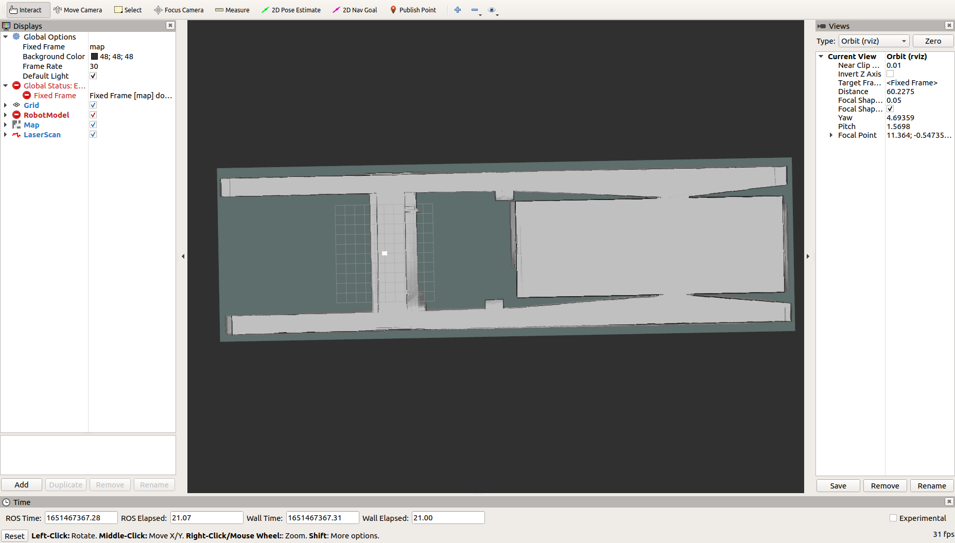
Issues
Cartographer accuracy

Slide 21
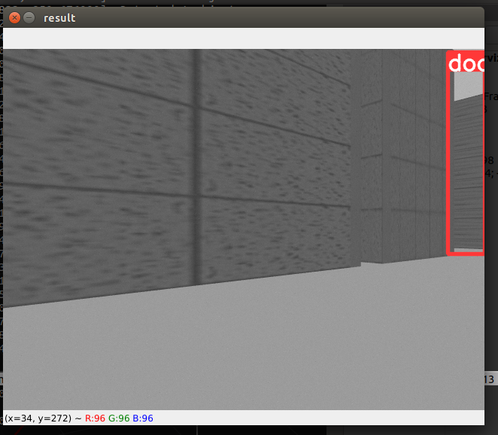
Issues
Filtering False-Positive detection

Slide 22
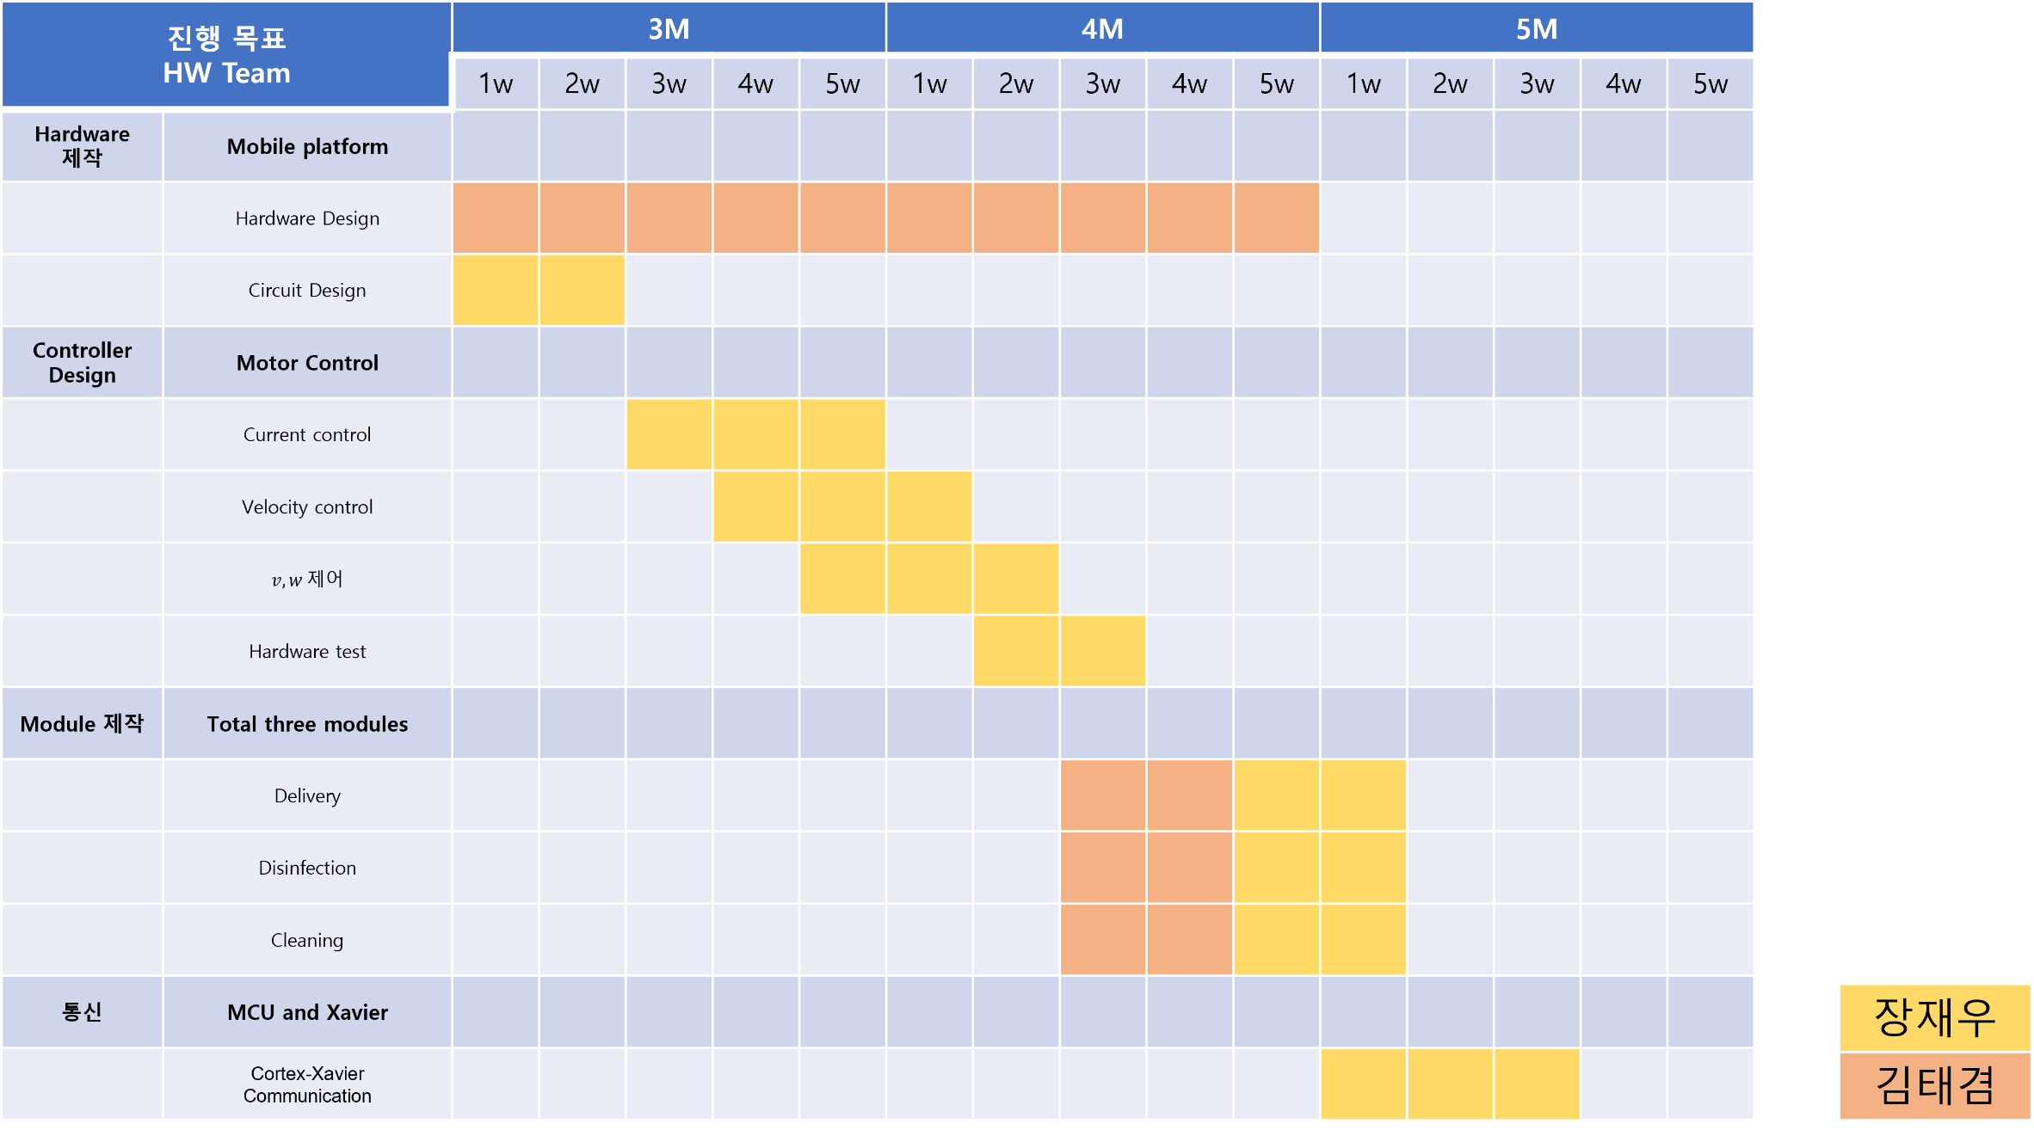
Schedule - HW

Slide 23
Schedule - SW

Slide 24
Q&A
Thank you

